Slide 1
Java I/O - I
Lecture 22

Slide 2
Learning objectives:
After the completion of today’s session you will be able to:
Learn the basics of java i/o
Illustrate the use of stream in java

Slide 3
Introduction
Java I/O (Input and Output) is used to process the input and produce the output based on the input.
Java uses the concept of stream to make I/O operation fast. The java.io package contains all the classes required for input and output operations.
We can also perform file handling in java by java IO API.

Slide 4
Stream
Stream: an object that either delivers data to its destination (screen, file, etc.) or that takes data from a source (keyboard, file, etc.)
it acts as a buffer between the data source and destination
Input stream: a stream that provides input to a program
System.in is an input stream
Output stream: a stream that accepts output from a program
System.out is an output stream
A stream connects a program to an I/O object
System.out connects a program to the screen
System.in connects a program to the keyboard

Slide 5
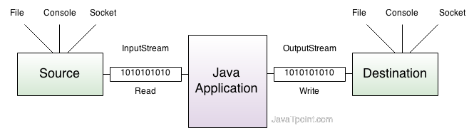
InputStream and OutputStream diagram

Slide 6
Types of Stream
There are two kinds of streams:
Byte Streams
Character Streams

Slide 7
Byte Stream
Byte streams provide a convenient means for handling input and output of bytes.
Byte streams are used, for example, when reading or writing binary data like image data, audio, video etc.
Byte streams create binary files.
A binary file essentially contains the memory image of the data. That is, it stores bits as they are in memory.
Binary files are faster to read and write because no translation need take place.
Binary files, however, cannot be read with a text editor.

Slide 8
Byte Stream classes
Byte streams are defined by using two class hierarchies.
At the top are two abstract classes:
InputStream and
OutputStream.

Slide 9
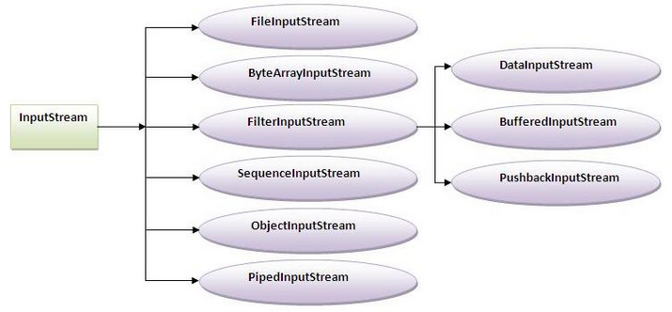
InputStream class: InputStream class is an abstract class. It is the superclass of all classes representing an input stream of bytes.

Slide 10
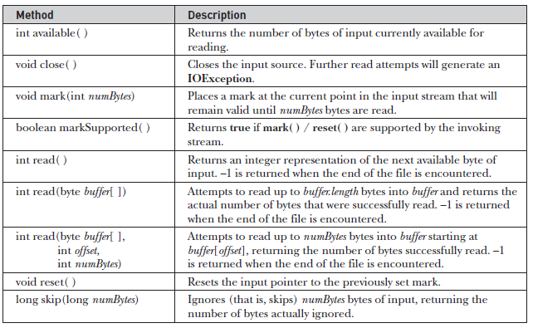
Methods in InputStream class

Slide 11
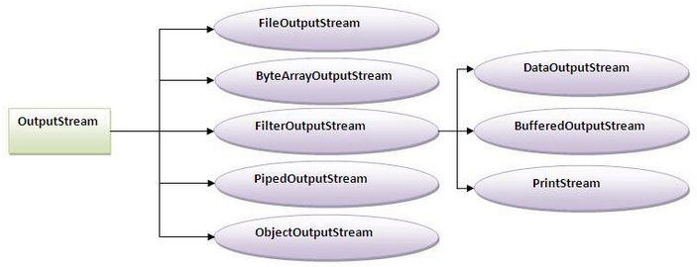
OutputStream class: OutputStream class is an abstract class. It is the superclass of all classes representing an output stream of bytes. An output stream accepts output bytes and sends them to some sink.

Slide 12
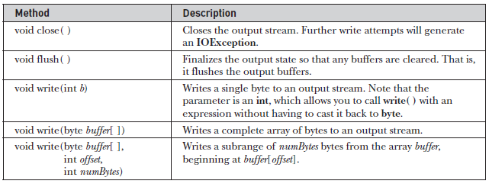
Methods in OutputStream class

Slide 13
Character Stream
Character streams provide a convenient means for handling input and output of characters.
Also, in some cases, character streams are more efficient than byte streams.
Character streams create text files.
These are files designed to be read with a text editor.
Java automatically converts its internal unicode characters to the local machine representation (ASCII in our case).

Slide 14
Character Stream classes
Character streams are defined by using two class hierarchies.
At the top are two abstract classes:
Reader and
Writer

Slide 15
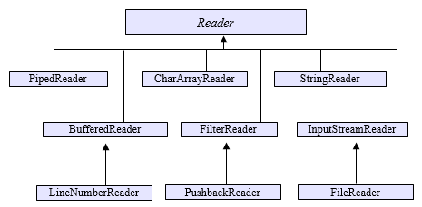
Reader class: Reader is an abstract class that defines Java’s model of streaming character input. It implements the AutoCloseable, Closeable, and Readable interfaces. All of the methods in this class (except for markSupported( )) will throw an IOException on error conditions..

Slide 16
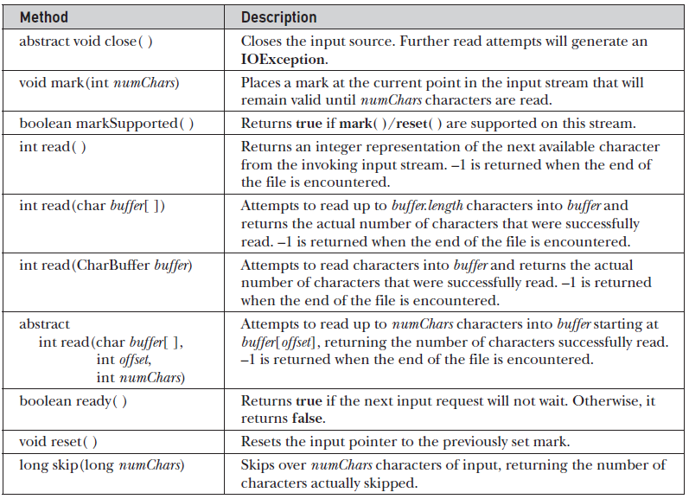
Methods in Reader class

Slide 17
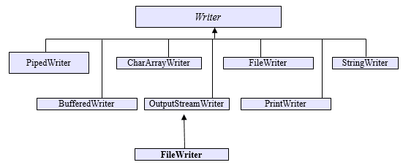
Writer class: Writer is an abstract class that defines streaming character output. It implements the AutoCloseable, Closeable, Flushable, and Appendable interfaces. All of the methods in this class throw an IOException in the case of errors.

Slide 18
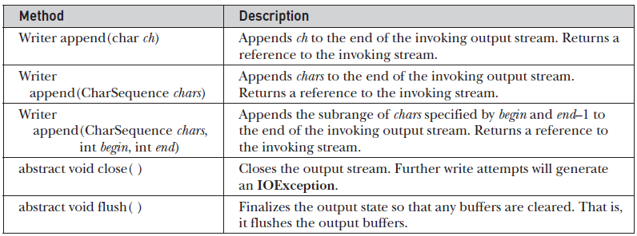
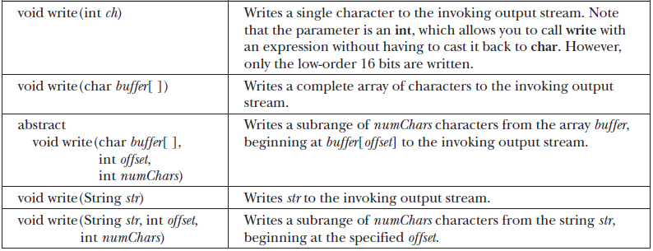
Methods in Writer class

Slide 19
Thanks

